Slide 1



CINEA/EMFAF/2021/3.1.2/03/SC04/SI2.881222
Specific Contract 2021/3.1.2/03/SC04
“Hosting, maintenance and further development of the Regional Database for the Mediterranean and Black Seas”
(implementation period: 01/04/2023 – 31/03/2025)
2nd Training
20-24 January 2025
RDBFIS II progress work

Slide 2
RDBFIS progress work -> populate the system with data
Aggregated data
Med&BS
FDI (Tables A, B, G, H, I, J)
AER
GFCM/DCRF
MEDITS (TA, TB, TC)
Detailed biological & landings data
A straight-forward process to upload data
Step 1. Syntax check (validation scheme)
csv
Step 2. Consistency check (quality control routines)
Step 3. Upload (update RDBFIS)
Notes:
A data call was drafted to the relevant Member States of the Med&BS region. The requested datasets covers the periods of the DCR & DCF programs
2002-2022 for Med&BS datacall,
2013-2022 for FDI datacall,
2017-2022 for GFCM/DCRF datacall,
Med&BS RCG data (DCR & DCF: fishing intensity, landings).
Detailed biological data
MEDITS data
AER data
The JRC and GFCM provided the requested datasets;
The Member States are invited to use the RDBFIS to execute syntax and data quality control procedures and store the clean data into the system (through a strict set of validation rules solid based on the datacall ANNEXES). A dedicated RDBFIS team support this process through bilateral contacts and working jointly with the Member States. The process is progressing satisfactorily, the RDBFIS core team supports all MSs’ requirements.

Slide 3


RDBFIS progress work -> surveys
MEDITS & MEDIAS integration within RDBFIS
1. MEDIAS database structure
Acoustics, Pelagic trawl, CTDs
2. Integration with RDBFIS
3. Validation scheme (acoustics, pelagic trawl)
4. Consistency check (R)
5. Processing (SQL)
Abundance, Biomass, Abundance-Biomass
6. Eggs & Larvae database structure
7. The MEDIAS data call is in progress,
Four workshops have been conducted
Integration & updated versions
RoME
RoMEBS
BioIndex integration
In the framework of the projects Qualitrain and RDBFIS, improvements were made on the R packages supporting the data quality and processing.
Within RDBFIS, the packages have been updated, replacing the older versions.

Slide 4

RDBFIS progress work -> AER integration
The aim is to support the MS to perform syntax and consistency checks before submitting data to the JRC. This results in a reduction of discrepancies between the AER and FDI datacalls (cross checking between AER & FDI is a goal for the project)
Specific economic performance indicators for STECF EWG purposes are currently under construction (NISEA&HCMR)
Clean data ready for submission
Member States
Syntax & Consistency
JRC
Upload
Notes:
A data call was drafted to the relevant Member States of the Med&BS region. The requested datasets covers the periods of the DCR & DCF programs
2002-2022 for Med&BS datacall,
2013-2022 for FDI datacall,
2017-2022 for GFCM/DCRF datacall,
Med&BS RCG data (DCR & DCF: fishing intensity, landings).
Detailed biological data
MEDITS data
AER data
The JRC and GFCM provided the requested datasets;
The Member States are invited to use the RDBFIS to execute syntax and data quality control procedures and store the clean data into the system (through a strict set of validation rules solid based on the datacall ANNEXES). A dedicated RDBFIS team support this process through bilateral contacts and working jointly with the Member States. The process is progressing satisfactorily, the RDBFIS core team supports all MSs’ requirements.

Slide 5
This innovative R package is designed to estimate the spatial effort, weight, and value of landings in small-scale fisheries (SSF) for data-limited scenarios, specifically for vessels under 12 meters in length. The R package has been integrated into RDBFIS, facilitating the estimation of fishing effort and landings in the format of Tables H and I. The package enables users to apply the MCDA-derived proxy for fishing effort, combine it with Tables A and G (as submitted in the data call), integrate results from species distribution models, and estimate spatial effort, landings, and value by fishing rectangle or at finer resolutions. The tool also generates maps to visualize these estimations.
RDBFIS progress work -> Estimating the spatial FE & landings for SSF (FDI Tables H, I)
-> integration within RDBFIS

Slide 6
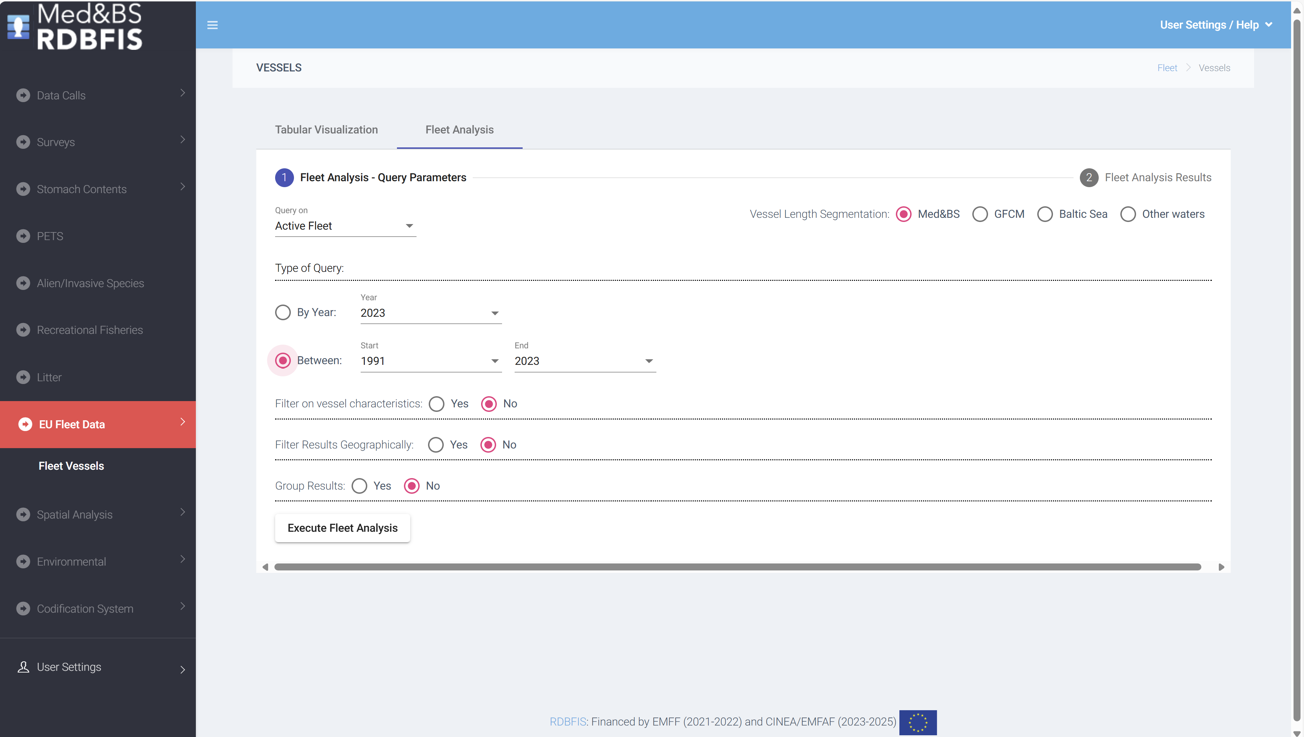
RDBFIS progress work -> EU fleet analysis
Fleet analysis: an open access dynamic tool has developed to illustrate the evolution of the fleet dynamics in Europe; potential links with the landings, discards and value (FDI Table A);
Data from the professional fishing fleet, spanning the period from 1991 to 2023, was downloaded from the official EU Fleet Register portal. GIS techniques were employed to spatially join the fishing ports with various geographical entities, including NUTS2 and NUTS3, FDI subregions, Geographical areas (GFCM, ICES). The fishing ports were match to LOCODE from the CIRCAMB Master Data Register. The accuracy of the fishing port locations was validated using information available from the IFREMER Sextant portal.
Reports can be generated based on user-defined queries about active or decommissioned fishing vessels
Notes:
fleet analysis tool: potential links with the landings/discards/values – FDI table A

Slide 7
RDBFIS progress work -> quality checks on FDI spatial data, Table H & I
-> Stomach contents data entry form, how RDBFIS can contribute to MSFD, common estimation system
Quality checks on FDI spatial data* (Table H & I):
Has been integrated, run on MS level (optional)
Maps & error reports are produced
*Maurizio GIBIN, Maciej ADAMOWICZ, Maksims KOVSARS
Stomach contents
Med&BS and ICES structures were adopted; User friendly data entry form
Eggs&Larvae
Database and data entry form
RDBFIS → MSFD
Predefined queries to mine data from RDBFIS and deliver to MSFD experts
The activity has been completed in terms of gathering information from MSFD experts
Common raising procedures for the Med&BS biological data - The aim was to review the existing statistical systems and the raising procedures currently implemented by the Med&BS MS for biological data. Bilateral meetings intended to gather relevant information, have been completed.
Notes:
STAT: The scope of the workshop will be twofold: (i) to provide the background information on the existing statistical systems of the involved MSs (by means of a report) and (ii) to investigate the possibility of optimizing /adapting (if needed) the most commonly used methodology on the raising procedures so that it can serve as a recommended option to be followed by the MSs of the Med and Black Sea through the RDBFIS.
2002-2022 for Med&BS datacall,
2013-2022 for FDI datacall,
2017-2022 for GFCM/DCRF datacall,
Med&BS RCG data (DCR & DCF: fishing intensity, landings).
Detailed biological data
MEDITS data
AER data
The JRC and GFCM provided the requested datasets;
The Member States are invited to use the RDBFIS to execute syntax and data quality control procedures and store the clean data into the system (through a strict set of validation rules solid based on the datacall ANNEXES). A dedicated RDBFIS team support this process through bilateral contacts and working jointly with the Member States. The process is progressing satisfactorily, the RDBFIS core team supports all MSs’ requirements.

Slide 8
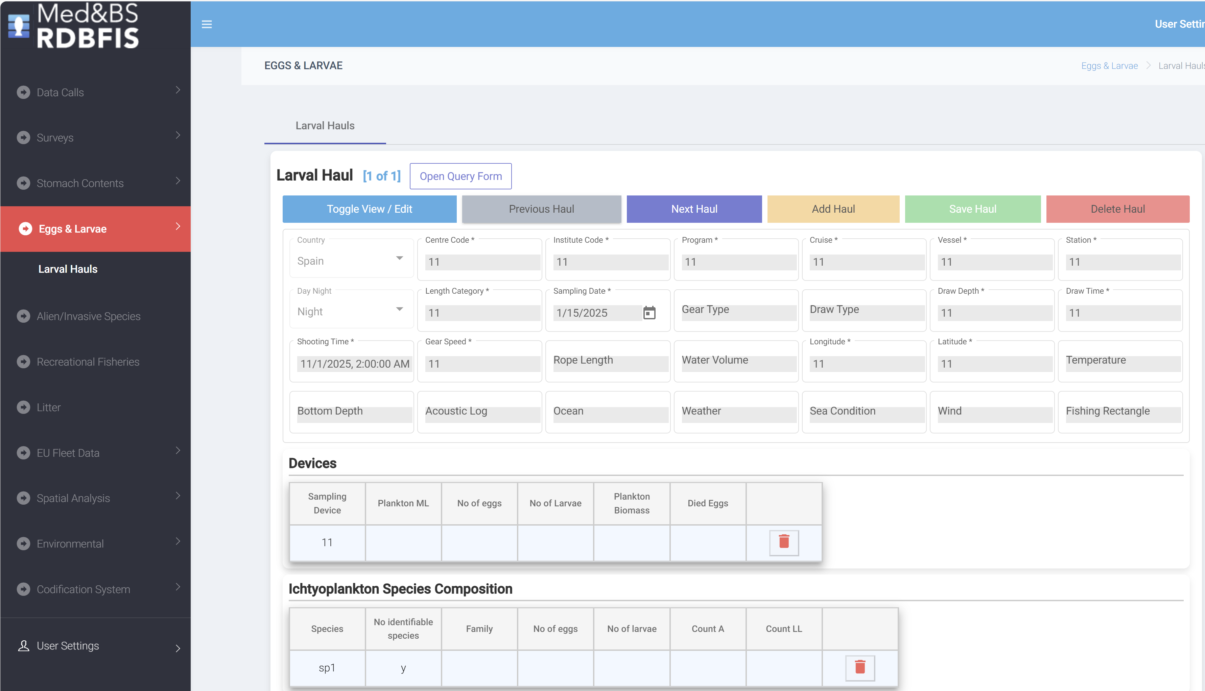
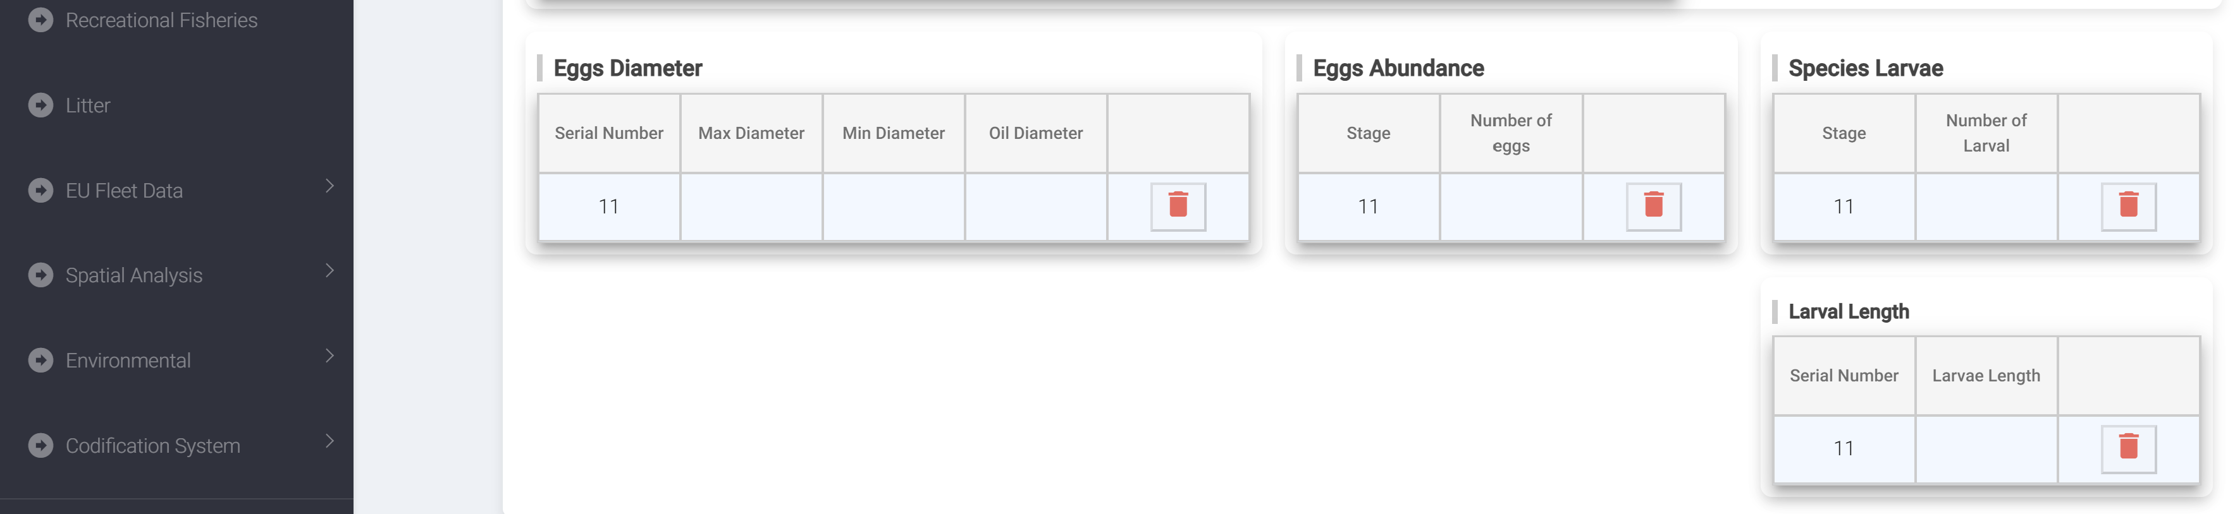
RDBFIS progress work -> Eggs&Larvae data entry form
Notes:
STAT: The scope of the workshop will be twofold: (i) to provide the background information on the existing statistical systems of the involved MSs (by means of a report) and (ii) to investigate the possibility of optimizing /adapting (if needed) the most commonly used methodology on the raising procedures so that it can serve as a recommended option to be followed by the MSs of the Med and Black Sea through the RDBFIS.
2002-2022 for Med&BS datacall,
2013-2022 for FDI datacall,
2017-2022 for GFCM/DCRF datacall,
Med&BS RCG data (DCR & DCF: fishing intensity, landings).
Detailed biological data
MEDITS data
AER data
The JRC and GFCM provided the requested datasets;
The Member States are invited to use the RDBFIS to execute syntax and data quality control procedures and store the clean data into the system (through a strict set of validation rules solid based on the datacall ANNEXES). A dedicated RDBFIS team support this process through bilateral contacts and working jointly with the Member States. The process is progressing satisfactorily, the RDBFIS core team supports all MSs’ requirements.

Slide 9
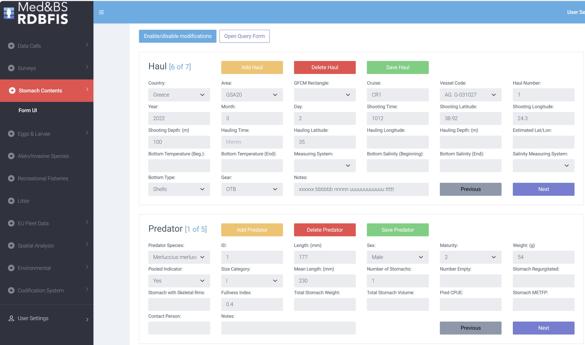
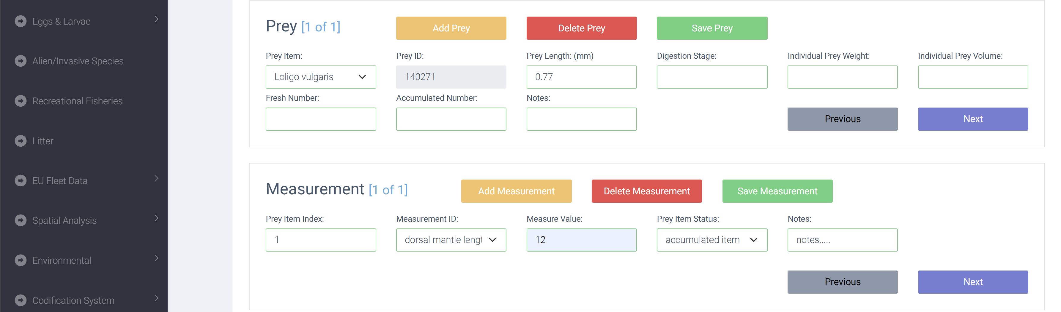
RDBFIS progress work -> Stomach contents data entry form
Notes:
STAT: The scope of the workshop will be twofold: (i) to provide the background information on the existing statistical systems of the involved MSs (by means of a report) and (ii) to investigate the possibility of optimizing /adapting (if needed) the most commonly used methodology on the raising procedures so that it can serve as a recommended option to be followed by the MSs of the Med and Black Sea through the RDBFIS.
2002-2022 for Med&BS datacall,
2013-2022 for FDI datacall,
2017-2022 for GFCM/DCRF datacall,
Med&BS RCG data (DCR & DCF: fishing intensity, landings).
Detailed biological data
MEDITS data
AER data
The JRC and GFCM provided the requested datasets;
The Member States are invited to use the RDBFIS to execute syntax and data quality control procedures and store the clean data into the system (through a strict set of validation rules solid based on the datacall ANNEXES). A dedicated RDBFIS team support this process through bilateral contacts and working jointly with the Member States. The process is progressing satisfactorily, the RDBFIS core team supports all MSs’ requirements.

Slide 10

RDBFIS overview
Med&BS RDB
Med&BS dc
FDI dc
GFCM/DCRF dc
Detailed bio data
MEDITS, MEDIAS, Eggs&Larvae
EU Fleet
Stomach content
PETS
Alien species
Recreational
Coding
Environmental
Spatial data
Components
UI
Validation schemes
RDBqc
RDBprocessing
RoME, RoMEBS
BioIndex
EU fleet analysis
MCDA for SSF
FDI spatial checks
Mapping
Stomach content & Eggs&Larvae data entry forms
Notes:
STAT: The scope of the workshop will be twofold: (i) to provide the background information on the existing statistical systems of the involved MSs (by means of a report) and (ii) to investigate the possibility of optimizing /adapting (if needed) the most commonly used methodology on the raising procedures so that it can serve as a recommended option to be followed by the MSs of the Med and Black Sea through the RDBFIS.
2002-2022 for Med&BS datacall,
2013-2022 for FDI datacall,
2017-2022 for GFCM/DCRF datacall,
Med&BS RCG data (DCR & DCF: fishing intensity, landings).
Detailed biological data
MEDITS data
AER data
The JRC and GFCM provided the requested datasets;
The Member States are invited to use the RDBFIS to execute syntax and data quality control procedures and store the clean data into the system (through a strict set of validation rules solid based on the datacall ANNEXES). A dedicated RDBFIS team support this process through bilateral contacts and working jointly with the Member States. The process is progressing satisfactorily, the RDBFIS core team supports all MSs’ requirements.

Slide 11
RDBFIS 1st and 2nd training
RDBFIS 1st training 17-19 September 2024 (online):
The training was highly successful, with many participants expressing strong interest in learning on the system, including new scientists who did not participated in the bilateral meetings that started in December 2023.
A second hybrid five-day meeting will be held from January 20 to 24, 2025.
Notes:
STAT: The scope of the workshop will be twofold: (i) to provide the background information on the existing statistical systems of the involved MSs (by means of a report) and (ii) to investigate the possibility of optimizing /adapting (if needed) the most commonly used methodology on the raising procedures so that it can serve as a recommended option to be followed by the MSs of the Med and Black Sea through the RDBFIS.
2002-2022 for Med&BS datacall,
2013-2022 for FDI datacall,
2017-2022 for GFCM/DCRF datacall,
Med&BS RCG data (DCR & DCF: fishing intensity, landings).
Detailed biological data
MEDITS data
AER data
The JRC and GFCM provided the requested datasets;
The Member States are invited to use the RDBFIS to execute syntax and data quality control procedures and store the clean data into the system (through a strict set of validation rules solid based on the datacall ANNEXES). A dedicated RDBFIS team support this process through bilateral contacts and working jointly with the Member States. The process is progressing satisfactorily, the RDBFIS core team supports all MSs’ requirements.

Slide 12
Future bilateral meetings of RDBFIS,
specificities at national level that need to be addressed by RDBFIS
Bilateral meetings
Finalize the detailed biological data
MEDIAS data upload
Support the MS to prepare the 2025 data call
Upload MEDITS data for the period 1994-2001
Upload 2023 data
Specificities at national level that need to be addressed by RDBFIS
Notes:
STAT: The scope of the workshop will be twofold: (i) to provide the background information on the existing statistical systems of the involved MSs (by means of a report) and (ii) to investigate the possibility of optimizing /adapting (if needed) the most commonly used methodology on the raising procedures so that it can serve as a recommended option to be followed by the MSs of the Med and Black Sea through the RDBFIS.
2002-2022 for Med&BS datacall,
2013-2022 for FDI datacall,
2017-2022 for GFCM/DCRF datacall,
Med&BS RCG data (DCR & DCF: fishing intensity, landings).
Detailed biological data
MEDITS data
AER data
The JRC and GFCM provided the requested datasets;
The Member States are invited to use the RDBFIS to execute syntax and data quality control procedures and store the clean data into the system (through a strict set of validation rules solid based on the datacall ANNEXES). A dedicated RDBFIS team support this process through bilateral contacts and working jointly with the Member States. The process is progressing satisfactorily, the RDBFIS core team supports all MSs’ requirements.

Slide 13
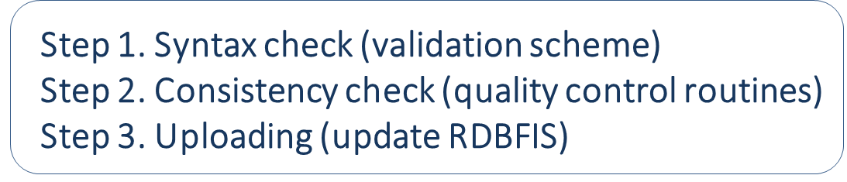

submission of data from RDBFIS to JRC
Initial proposal ….
MS
.csv
Med&BS RDB
Submit to JRC
JRC DB
… but: a) there are commission policy issues regarding data, b) is a much bigger task to alter the stringent institutional security bureaucracy

Slide 14
The plan for the 2025 data call
MS/RDB*
JRC UI for data VALIDATION & UPLOAD
.csv
JRC DB
MS
.csv
Med&BS RDB
*The RDB super user can export from RDBFIS the 2024 data sets from all MS and submit them through JRC upload tool

Slide 15
RDBFIS III
Establishment of the Regional Database for the Mediterranean and Black Seas
Acronym: Med&BS RDBFIS-III
Under FRAMEWORK CONTRACT – EASME/EMFF/2020/OP/0021
Framework Contract for the provision of scientific advice
for the Mediterranean and the Black Seas
Specific Contract CINEA/EMFAF/2024/3.1/01/SC08
Contractor: Hellenic Centre for Marine Research (HCMR)
Specific Contract Project Coordinator: Dr. Irida Maina (HCMR)
Scientific Information Technology Coordinator: Stefanos Kavadas
Duration: 13 months and 21 days
Project Start: April 1st 2025

Slide 16
RDBFIS III - further development
During the project implementation, twelve activities will be carried out to support the following eight objectives:
O1. database maintenance and restructuring
O2. enhancement and optimization of the existing programming code (Update/revision of existing data quality tools, tools4MCDA, spatial visualization, Improvement and further development of the existing validation scheme and consistency checks)
O3. common raising procedures for the Med&BS biological data
O4. development of new software packages (Development of data quality tools: MEDIAS, stat4RDBFIS software Package development)
O5. integration within RDBFIS of the existing sampling optimization package
O6. fleet analysis updates and improvements on FDI spatial checks
O7. integration within RDBFIS of the outcomes of MAPAFISH project
O8. Fine-tuning

Slide 17
RDBFIS in the future (DCF NC meeting 26/09/2024)
With the support of National Correspondents and DCF experts, the system is evolving into a highly effective tool for the Med&BS RCG, Member States, users authorized by the National Correspondents and other potential end users (e.g. STECF).
Furthermore, new features are set to be integrated, highlighting it as a state-of-the-art fisheries information system for the Med&BS. As the system will continue to operate in the future, is a major achievement for Member States to encourage its use and support the further development.
In the period leading up to the end of this year, we need to strengthen our collaboration (MS and RDBFIS) to ensure the completion of detailed biological data uploads.

Slide 18
CINEA/EMFAF/2021/3.1.2/03/SC04/SI2.881222
Specific Contract 2021/3.1.2/03/SC04
Hosting, maintenance and further development of the Regional Database for the Mediterranean and Black Seas
https://rdbfis.eu
Significant contribution by
Executive Agency for Fisheries and Aquaculture, Bulgaria (Simona Vasileva NICHENA)
Ministry of Agriculture, Directorate of Fisheries, Croatia (Ivana VUCOV)
Fisheries Research Unit, Department of Fisheries and Aquaculture, Malta (Jurgen Mifsud)
Maurizio GIBIN, Maciej ADAMOWICZ, Maksims KOVSARS

